Slide 1
RUAHA CATHOLIC UNIVERSITY
RMS 222 - BUSINESSES & ENTREPRENEURSHIP
Double Entry System for Financial Statement Elements

Slide 2
THE ACCOUNTING EQUATION
Financial Accounting is based upon one fundamental idea, called the accounting equation.
The idea is explained by the fact that for a firm to start trading it needs resources. These resources can be supplied by the owner or outside parties.
The form of the accounting equation will then depend on who has supplied the resources used in the business.

Slide 3
THE ACCOUNTING EQUATION (Cont.)
Where the resources have been supplied solely by the owner:
Resources in the business = Resources supplied by the owner
In accounting terms, the amount of resources supplied by the owner is called capital;
The actual resources that are then in the business are called assets.
The above equation can then be rewritten as
ASSETS = CAPITAL
In the normal course of business, outsiders do supply part of the resources needed to run the business. Amount owing to these outsiders is known as liabilities.
The above equation then changes into
ASSETS = CAPITAL + LIABILITIES

Slide 4
THE ACCOUNTING EQUATION (Cont.)
The two sides of the equation will always be equal, the right-hand side representing where the money came from, and the left-hand side representing what it was used for or what it represents.

Slide 5
THE ACCOUNTING EQUATION (Cont.)
Assets consist of property of all kinds:
Premises/buildings, office equipment, motor vehicles, plant and machinery
Stocks of goods intended for sale, raw materials, manufactured/finished goods
Bank balances
Cash balances
Debtors (people who owe money to the organization)
Other receivables

Slide 6
THE ACCOUNTING EQUATION (Cont.)
Capital is the money provided to the business by the owner(s). This might have been put in at the beginning of the business, or it might have been added to during the life of the business, either by additional capital being provided, or by profits made which have been left in the business.
If the owner(s) has/have withdrawn capital in terms of cash, goods or other items for personal use, this is known as drawings and it reduces the amount of capital.
Capital is also known as owner’s equity or net worth.

Slide 7
THE ACCOUNTING EQUATION (Cont.)
Liabilities are amounts which the business owes to other people and organizations (outsiders). These include:
Loans from banks or other lenders, money borrowed from friends.
Bank overdrafts
Creditors (people to whom the organization owes money because it has purchased goods or services on credit).
Any other payables

Slide 8
THE BALANCE SHEET AND BUSINESS TRANSACTIONS
The accounting equation is expressed in a financial position statement called the balance sheet.
A balance sheet is defined as the statement showing the financial position of the organization in form of summary of value of assets owned and assets owed.
As the two sides of the accounting equation have to agree all the time, even the balance sheet has to balance (as it is the expression of the accounting equation).
Sometimes it is said that the balance sheet is a sheet that balances.

Slide 9
FORM OF THE BALANCE SHEET
The balance sheet has to display the following
information:
The Business name
Balance sheet date
Example:
Home Business Center Balance Sheet as at 31 December 2010
A summary of the effect of transactions upon assets, liabilities and capital is shown below.
Assets
Capital &Liabilities

Slide 10
Example of transaction | Effect
1. Buy goods on credit | Increase asset(Stock of goods) & Increase liability(Creditors)
2. Buy goods by cheque | Increase asset(Stock of goods) & Decrease asset(Bank)
3. Pay creditor by cheque
4. Owner pays more capital into the bank
5.Drawings (from bank account)
6.Owner pays creditor from private money outside the firm

Slide 11
Example of transaction | Effect
1. Buy goods on credit | Increase asset(Stock of goods) & Increase liability(Creditors)
2. Buy goods by cheque | Increase asset(Stock of goods) & Decrease asset(Bank)
3. Pay creditor by cheque | Decrease assets(Bank) & Decrease Liability(Creditors)
4. Owner pays more capital into the bank
5.Drawings (from bank account)
6.Owner pays creditor from private money outside the firm

Slide 12
Example of transaction | Effect
1. Buy goods on credit | Increase asset(Stock of goods) & Increase liability(Creditors)
2. Buy goods by cheque | Increase asset(Stock of goods) & Decrease asset(Bank)
3. Pay creditor by cheque | Decrease assets(Bank) & Decrease Liability(Creditors)
4. Owner pays more capital into the bank | Increase asset(Bank) & Increase capital
5.Drawings (from bank account)
6.Owner pays creditor from private money outside the firm

Slide 13
Example of transaction | Effect
1. Buy goods on credit | Increase asset(Stock of goods) & Increase liability(Creditors)
2. Buy goods by cheque | Increase asset(Stock of goods) & Decrease asset(Bank)
3. Pay creditor by cheque | Decrease assets(Bank) & Decrease Liability(Creditors)
4. Owner pays more capital into the bank | Increase asset(Bank) & Increase capital
5.Drawings (from bank account) | Decrease asset(Bank) & Decrease capital
6.Owner pays creditor from private money outside the firm

Slide 14
Example of transaction | Effect
1. Buy goods on credit | Increase asset(Stock of goods) & Increase liability(Creditors)
2. Buy goods by cheque | Increase asset(Stock of goods) & Decrease asset(Bank)
3. Pay creditor by cheque | Decrease assets(Bank) & Decrease liability(Creditors)
4. Owner pays more capital into the bank | Increase asset(Bank) & Increase capital
5. Drawings (from bank account) | Decrease asset(Bank) & Decrease capital
6. Owner pays creditor from private money outside the firm | Decrease liability(Creditors) & Increase capital

Slide 15
DOUBLE ENTRY SYTEM
From the previous section, it can be seen that every transaction affects two items.
For each transaction then, two bookkeeping entries must be made, one showing an increase/decrease in on item, and the other showing an increase/decrease in the other item.
Hence the term double entry system of bookkeeping, as each entry is made twice (double entry).
The basis for this system is recording transactions in the accounts.
An account is a place where all the information referring to a particular asset, liability or capital is entered.

Slide 16
NATURE OF AN ACCOUNT
Each account is shown on a separate page in the book accounts (ledger)
Each page is divided into two halves.
The left-hand side of each page is called the DEBIT side
The right-hand side of each page is called the CREDIT side
The page of an accounts book looks as follows:
Title of account
DEBIT SIDE CREDIT SIDE

Slide 17
DOUBLE ENTRY RULES FOR ACCOUNTS
The double entry rules for assets, liabilities and capital accounts can be summarized as follows:
Accounts | To record | Entry in the account
ASSETS | An increase | Debit
 | A decrease | Credit
LIABILITIES | An increase | Credit
 | A decrease | Debit
CAPITAL | An increase | Credit
 | A decrease | Debit

Slide 18
DOUBLE ENTRY RULES FOR ACCOUNTS (Cont.)
The double entry rules for capital and liabilities are the same, but they are the opposite of those of assets.
This is because they are on the opposite side of the equation and therefore, follow the opposite rules

Slide 19
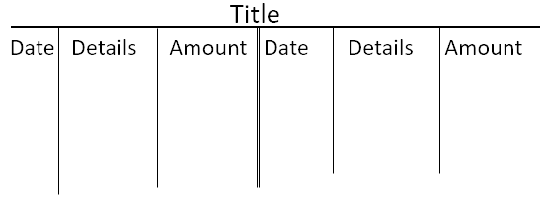
FORMAT OF AN ACCOUNT

Slide 20
ENTRY OF TRANSACTIONS
Makwega starts his business with Shs 1,000,000 in cash on 1 August 2010.
What is the effect of the transaction?
- Increases the asset of cash
- Increases the capital
Action to be made?
- Debit the cash account
- Credit the capital account

Slide 21
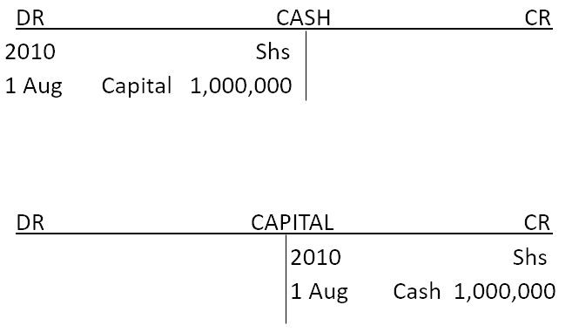
ENTRY OF TRANSACTIONS (Cont.)

Slide 22
ENTRY OF TRANSACTIONS (Cont.)
A motor van is bought for Shs 275,000 cash on 2 August 2010
What is the effect of the transaction?
What is the action to be made?
Fixtures are bought on credit from Kondoo Shop for Shs 115,000 on 3 August 2010.
What is the effect of the transaction?
What is the action to be made?
He paid the amount owing in cash to Kondoo Shop on 17 August 2010.
What is the effect of the transaction?
What is the action to be made?

Slide 23
DOUBLE ENTRY FOR THE ASSET OF STOCK
There is normally no “stock account” in the books of accounts.
This is, instead, represented by several accounts, each showing the movement of stock. This is movement is shown by increases or decreases in stock.
Increases in the stock can be due to additional purchases of goods, or the return (to the firm) of goods previously purchased.
Decreases in the stock of goods can be due to sale of goods, or returns of goods previously purchased.

Slide 24
STOCK ACCOUNT SUBDIVISIONS
Two accounts cater for the increases in stock:
Purchases Accounts: for purchases of goods
Returns Inwards Accounts: for goods being returned in the firm (also called sales Returns)
Accounts catering for the decrease of stocks are:
Sales Accounts: for sales of goods
Returns Outwards Account: for goods being returned out to a supplier
The double entry rules applying for assets apply to the above accounts (since they are connected to the asset of stock)

Slide 25
Caution:
“Purchases” in Accounting means the purchase of those goods which the firm buys with the prime intention of selling.
“Sales” means the sale of those goods in which the firm normally deals and which were bought with the prime intention of resale.

Slide 26
EFFECT OF PROFIT OR LOSS ON CAPITAL
The accountant’s meaning of profit is the amount by which revenues exceed expenses.
“Revenues” means the sales value of goods and services supplied to customers.
“Expenses” means the value of all the assets that have been used up to obtain revenues.
“Loss” is the amount by which expenses exceed revenues.
REVENUES – EXPENSES = PROFIT/LOSS
Therefore, profit is made when goods or services are sold at more than cost price and the opposite will result in a loss.

Slide 27
EFFECT OF PROFIT OR LOSS ON CAPITAL (Cont.)
Assets = Liabilities + Capital
Therefore, Assets – Liabilities = Capital
Any change in the left-hand side has to occur also in the right-hand side.
The change might result in profit, loss or drawings
Old capital + Profit = New capital
Old capital – Loss = New Capital
Old capital – Drawings = New capital

Slide 28
DOUBLE ENTRY FOR REVENUES AND EXPENSES
Expenses accounts are debited since they represent expenditure by the business (just as do the assets)
Revenues are the opposite of expenses, revenue accounts are credited
Expense accounts are such as Rent Account, Wages Account, Postages Account, Electricity, Insurance Accounts, etc.
Revenue accounts are accounts such as Rent Receivable Account, Interest Receivable Account, etc.

Slide 29
TYPES OF ACCOUNTS OF ACCOUNTS
Personal accounts: Debtors and Creditors accounts
Impersonal accounts: Real and Nominal accounts
Real accounts: for property (buildings, motor cars, machinery, fixtures,…)
Nominal accounts: expenses, income and capital accounts

Slide 30
BALANCING OFF ACCOUNTS
Finding and entering the difference between the two sides of an account on the lesser side, so as to equalize the two sides of the account
Stages:
Add up both sides to find out their totals
Deduct the smaller total from the larger total to find the balance
Enter the balance on the side with the smallest total
Enter the totals on a level with each other
Enter the balance on the line below the totals on the opposite side to the balance shown above the totals.

Slide 31
TRIAL BALANCE
Double entry bookkeeping means for every debit entry there is a corresponding credit entry and vice versa
Total debit entries = Total credit entries
To see if the totals equal or if the sides balance, a Trial balance is drawn at the end of the period
This is just a list of all balances from the closed accounts
If Total debit balances = Total credit balances, then we can be sure of the accuracy in balancing off the accounts or entering transactions in the accounts.

Slide 32
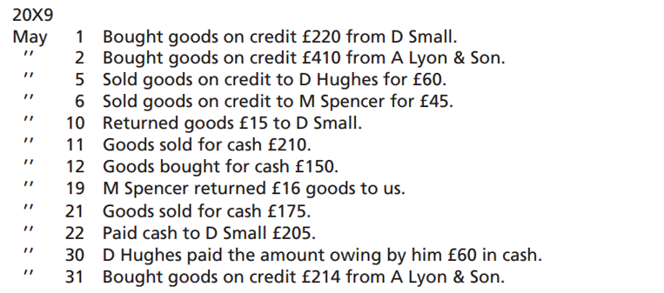
Exercise
Enter the following transactions in T-accounts.

Slide 33
END

